Slide 1
FRITO LAY CASE STUDY: Employee Attrition
Katherine Nguyen
Brought to you by DDSAnalytics

Slide 2

BACKGROUND
Who Are We?
DDSAnalytics - leveraging data science to provide talent management solutions for Fortune 100 companies
Purpose:
Optimize talent management at Frito Lay by identifying current attrition trends and predicting employee turnover using existing employee data

Slide 3
OBJECTIVES
Identify the top 3 factors contributing to turnover
Highlight specific job role trends that may exist in the data set
Predict attrition based on Naïve Bayes model

Slide 4
EXISTING DATA
870 anonymously surveyed employees
35 survey questions covering topics such as education/career background, demographics, job satisfaction, training time, etc.
Limited to jobs in Sales, Research & Development, and Human Resources

Slide 5
METHODOLOGY
Removed missing data
Identified continuous vs categorical data
Explored variables explaining attrition
Compared on accuracy, sensitivity, specificity, and F1
Developed 2 candidate classification models
Notes:
No missing data
Disregarded unnecessary variables: ID, employee number, over 18, and standard hours

Slide 6
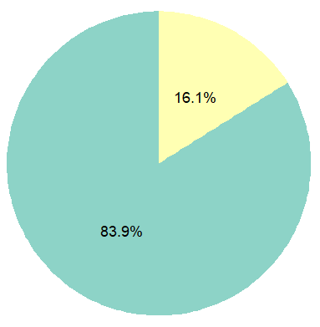
Data Set: Attrition Rate
Attrition Rate
As seen in the graphs, there is a 16.1% rate of attrition, compared to retention
 | No
 | Yes

Slide 7
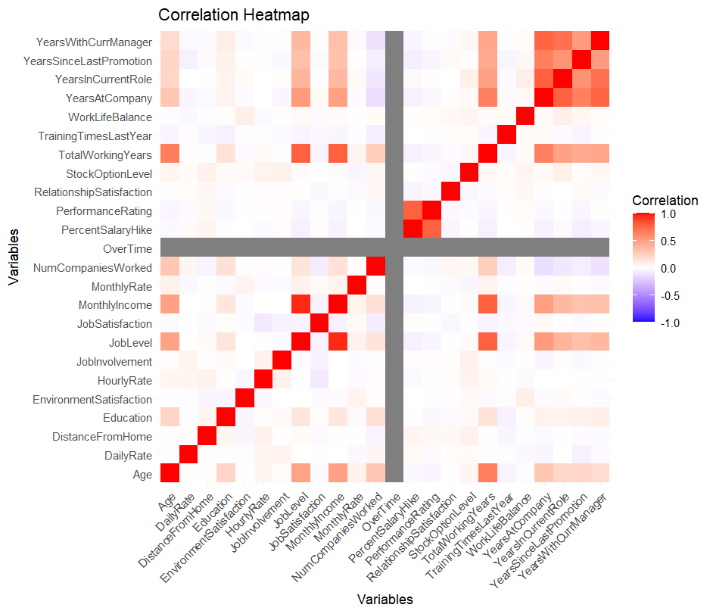
Heat Map: Big Picture Correlation
Factors
High rate of correlation between certain variables
Factors

Slide 8
Heat Map: Big Picture Correlation
High rate of correlation between certain variables

Slide 9
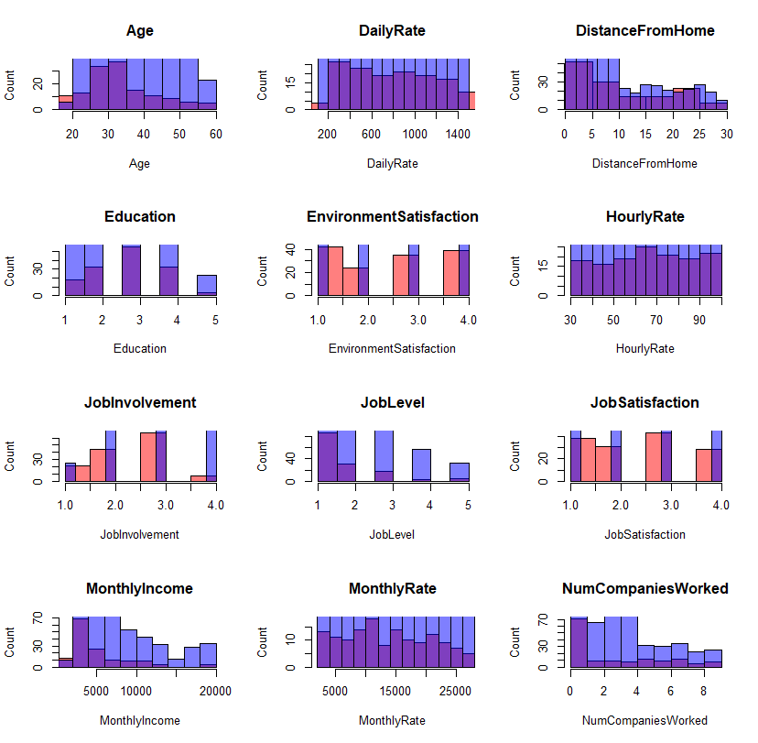
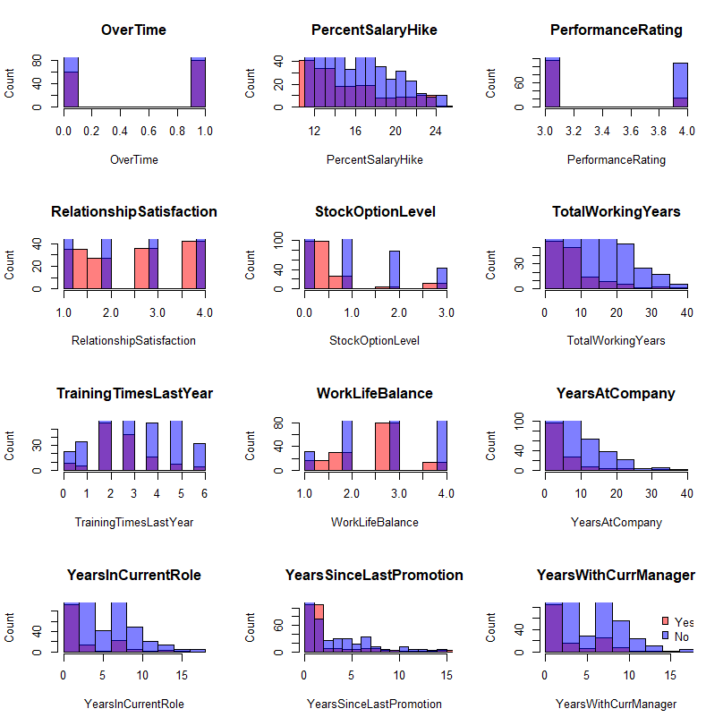
Big Picture: Correlation
Notes:
All have similar, no trend in correlation, drop the variables

Slide 10
Big Picture: Correlation
Notes:
Correlation with younger employees with higher attrition

Slide 11
Big Picture: Correlation
Notes:
Highlighting factors that I believe are contributing the most

Slide 12
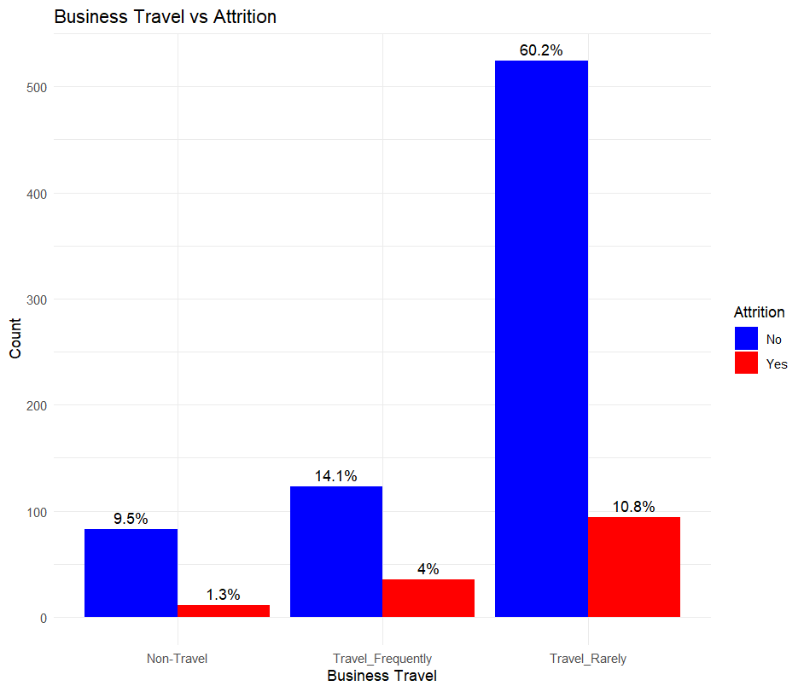
Big Picture: Correlation
Notes:
No significant trend

Slide 13
Effects of Job Role/Department

Slide 14
AVERAGE AGE BY JOB
Department | Job Role | Average Age Female | Average Age Male
Human Resources | Human Resources | 32.7 | 34.8
 | Manager | 49.3 | 48.4
Research & Development | Healthcare Representative | 38.8 | 39.6
 | Laboratory Technician | 35.6 | 33.4
 | Manager | 47.9 | 47.8
 | Manufacturing Director | 38.3 | 38.2
 | Research Director | 41.6 | 45.4
 | Research Scientist | 33.7 | 35.4
Sales | Manager | 47.4 | 46
 | Sales Executive | 38.2 | 35.7
 | Sales Representative | 31.4 | 29.6

Slide 15
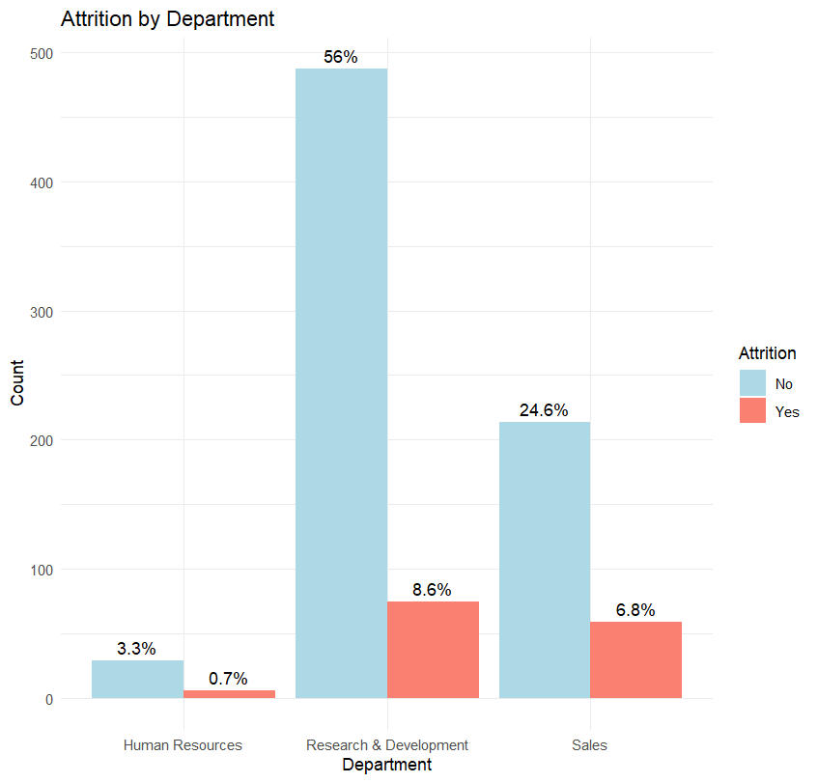
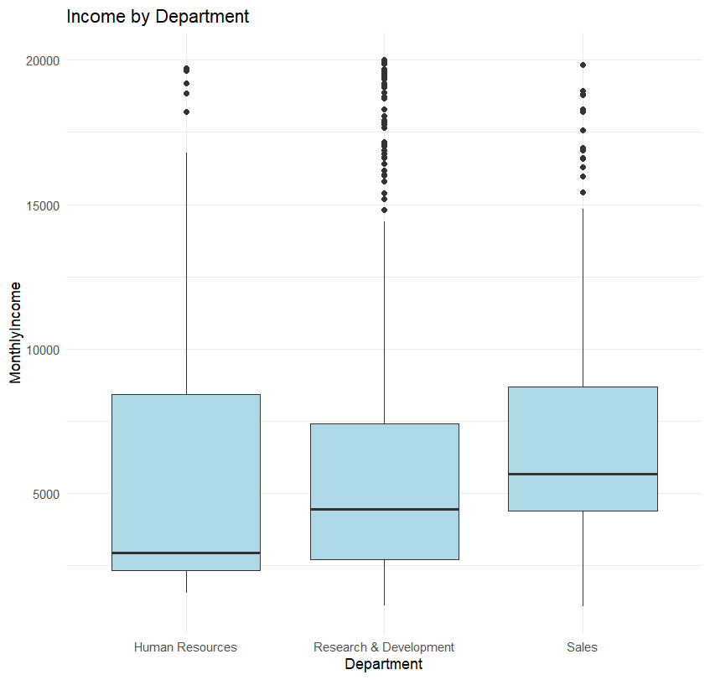
BY DEPARTMENT
Notes:
interesting to see that although sales had the greatest median monthly income, still had the second to lowest attrition rate

Slide 16
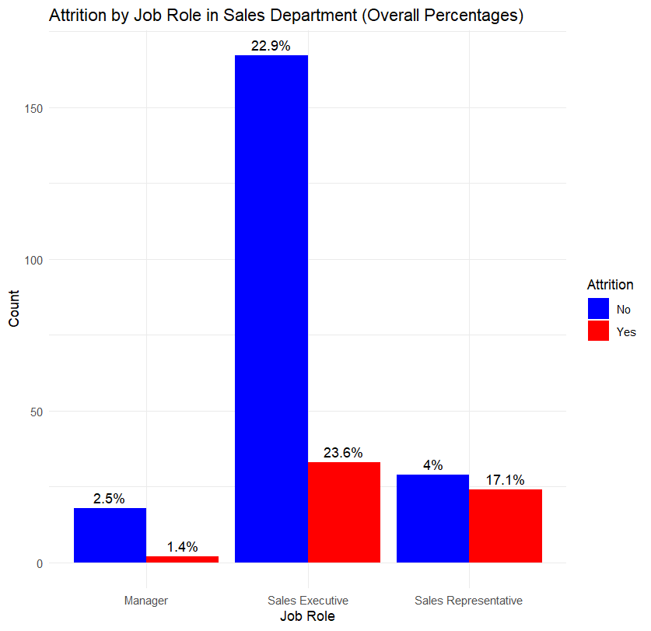
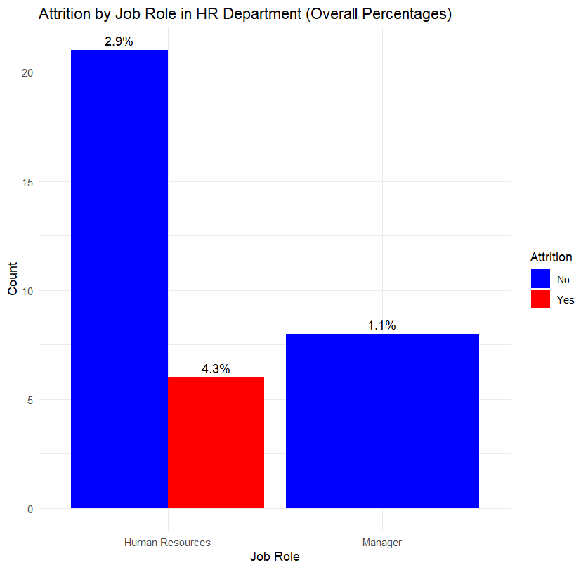
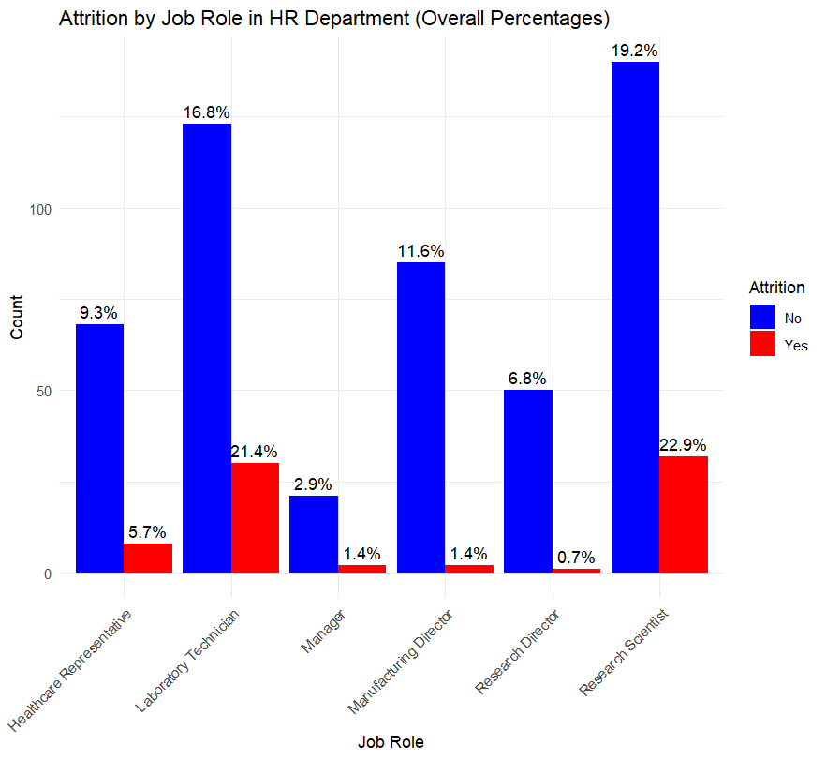
BY DEPARTMENT
Sales Executive and Research Scientist had the highest rates of attrition

Slide 17
Naïve Bayes Modeling
Notes:
simple and effective way to make predictions based on probabilities.

Slide 18
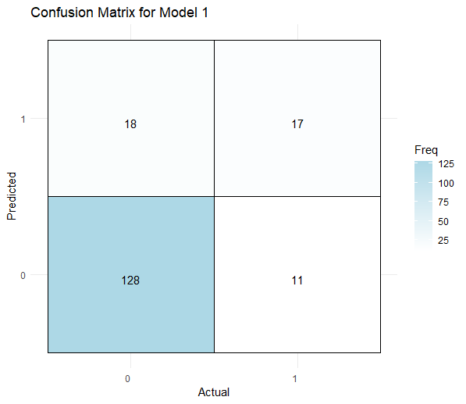
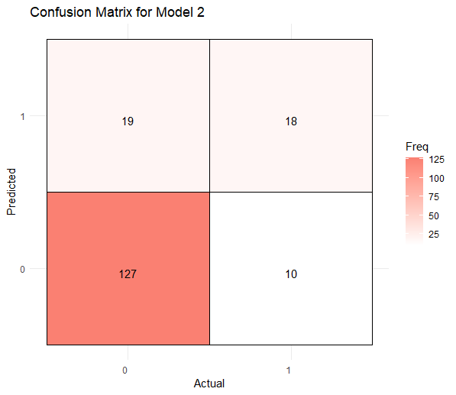
COMPARE 2 MODELS
 | Accuracy | Sensitivity | Specificity | F1
Model 1 | 83.3 | 87.7 | 60.7 | 89.8
Model 2 | 83.3 | 86.9 | 64.3 | 89.8
Notes:
Accuracy:
Both models achieved an accuracy of about 83.3%
Both did well at predicting whether an employee would stay or leave.
Sensitivity:
High, 87.7% and 86.9% for each model, respectively
Correctly identified those who actually left the company
Specificity:
60.7% for model 1 and 64.3% for model 2.
More false positives (as seen in plots)
Incorrectly predicted employees would leave than when they actually stayed
F1:
Both models returned NA
Failed to predict any employees leaving
Area of improvement

Slide 19
Thank you!
Please do not hesitate to contact me:
Katherine Nguyen | nguyenkh@smu.edu

